Slide 1

PYTHON APPLICATION PROGRAMMING
Chitra G M
Computer Science and
Engineering

Slide 2

PYTHON APPLICATION PROGRAMMING
Introduction
Chitra G M
Department of Computer Science and Engineering

Slide 3
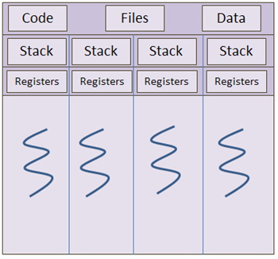
PYTHON APPLICATION PROGRAMMING
Multithreading, Multiprocessing
Thread
A thread is a lightweight process that can be managed independently by a scheduler.
Courtesy :Study.com

Slide 4
PYTHON APPLICATION PROGRAMMING
Multithreading, Multiprocessing
Thread
It improves the application performance using parallelism.
A thread shares information like data segment, code segment, files etc. with its peer threads while it contains its own registers, stack, counter etc.

Slide 5
PYTHON APPLICATION PROGRAMMING
Multithreading, Multiprocessing
Thread Creation
The Python standard library provides threading module to create threads.
Thread() is used to create threads.
To start a separate thread, you create a Thread instance and then tell it to .start():

Slide 6
PYTHON APPLICATION PROGRAMMING
Multithreading, Multiprocessing
Thread Creation
Example:
import threading
import time
def f1():
for i in range(1,5):
print(i)
time.sleep(1)
t1=threading.Thread(target=f1)
t1.start()

Slide 7
PYTHON APPLICATION PROGRAMMING
Multithreading, Multiprocessing
Thread methods
start()
  Start the thread’s activity.
  It must be called at most once per thread object. It arranges for the object’s run() method to be invoked in a separate thread of control.
  This method will raise a Runtime Error if called more than once on the same thread object.

Slide 8
PYTHON APPLICATION PROGRAMMING
Multithreading, Multiprocessing
Thread methods
join(timeout=None)
  Wait until the thread terminates. This blocks the calling thread until the thread whose join() method is called terminates – either normally or through an unhandled exception – or until the optional timeout occurs.

Slide 9
PYTHON APPLICATION PROGRAMMING
Multithreading, Multiprocessing
Thread methods
join(timeout=None)
  Wait until the thread terminates. This blocks the calling thread until the thread whose join() method is called terminates – either normally or through an unhandled exception – or until the optional timeout occurs.

Slide 10
THANK YOU
Chitra G M
Department of Computer Science and Engineering
chitragm@pes.edu
+91 9900300411

